Slide 1

Meera Enterprises Analysis Report_1.0
Last data refresh:
4/26/2020 8:06:07 PM India Standard Time
Downloaded at:
4/26/2020 8:09:12 PM India Standard Time

Slide 2
Consideration to build this Report
Base on “Example” Calculation in data source here is my understanding to build this report.
Item Type has purchase cost which is changing frequently base on “Purchase start Date and Order date” the purchase cost should mapped with respected “Order ID”.
Exchange Rate depend upon the Year when Order Placed.
Total Sales Amount in INR = Unit Sold * Sales Price per Unit($)* Exchange Rate (One $ To INR) at the Time Order Placed
Purchase Cost in INR= Unit Sold * Purchase Cost Per Unit ($) * Exchange Rate (One $ To INR) at the Time Order Placed
Good Will Amount Eligible or not = Based on “Shipment Annexure TAT” and “Goodwill Annexure” order values and Delayed time after Shipment TAT it mapped into respected row else the value of goodwill amount is 0.
Total Profit = Total Sales in INR – (Purchase Cost in INR +Goodwill amount in INR).
Profit % = (Total Profit / Total Sales amount in INR)

Slide 3
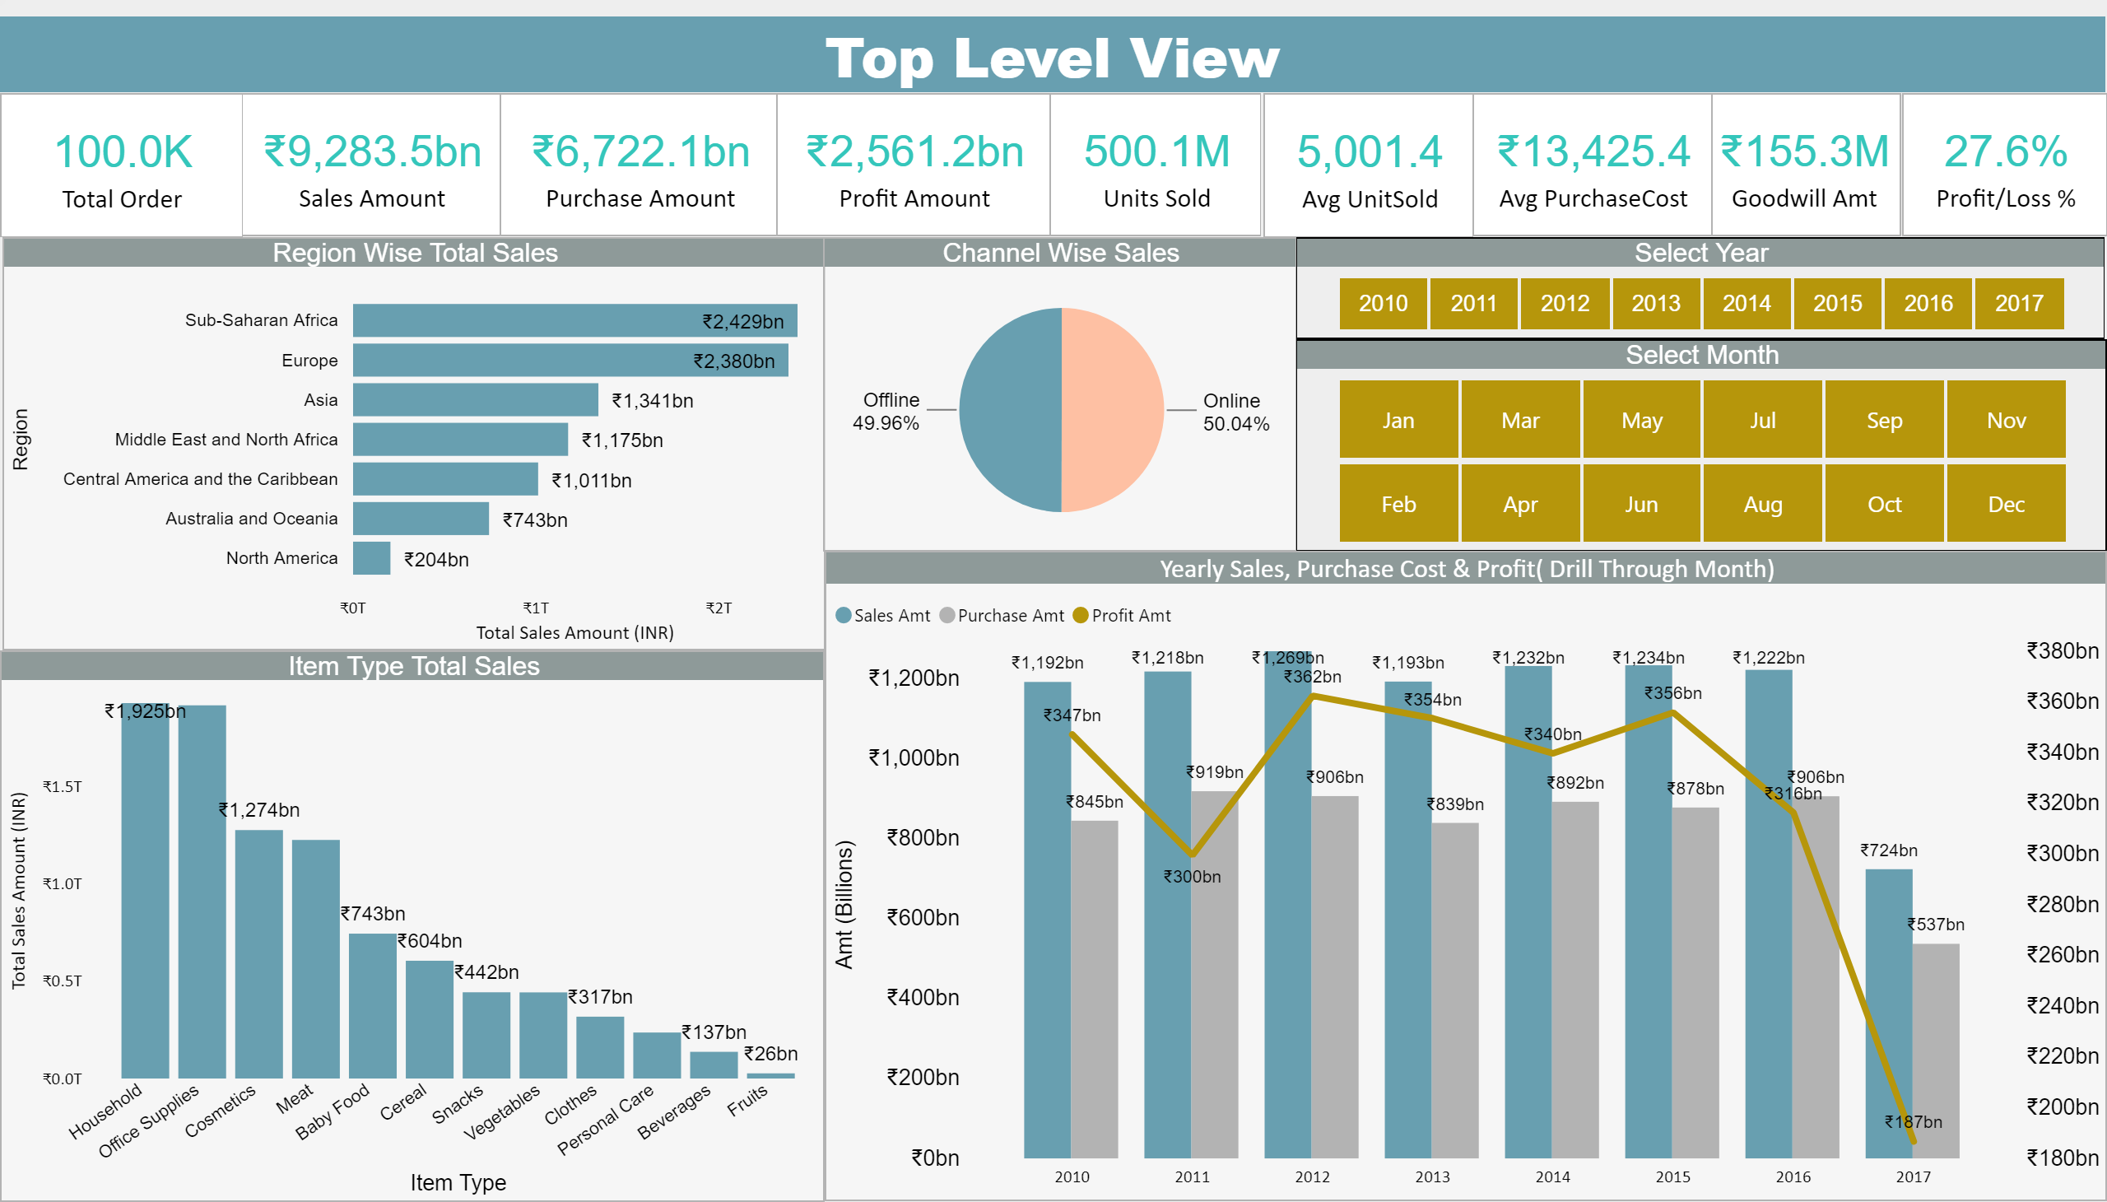
This is the top level view of Meera Enterprises sales historical data. This view gives insight of Total order, Sales Profits and other KPIs. These visualization represents overall summary of business by ITEM, Region and YoY performance. Right side corner has year and month selector for slicing and dicing the report ( visible in BI Tools).

Slide 4
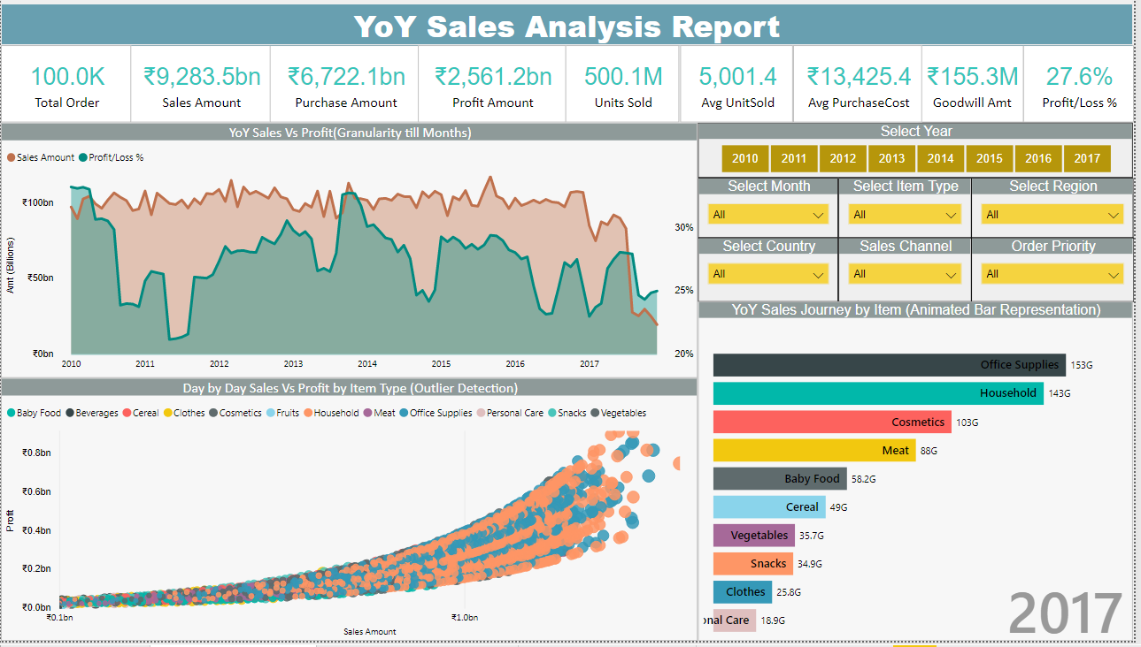
This reports focus on Timeseries analysis of Meera Enterprises. Its gives insights about the company trend over period of time with respect to sales and profit. The second report “Day by Day Sales Vs Profit by Item Type” gives the information of all the outlier deal on a single day(Order Date). Third report is Animated bar Chart shows us the Journey from first order to end of the date in term of Sales and Item. In the right side corner we have various filter like Item Time, Region, Country Sales channel to slice out visualization reports according to user story.

Slide 5
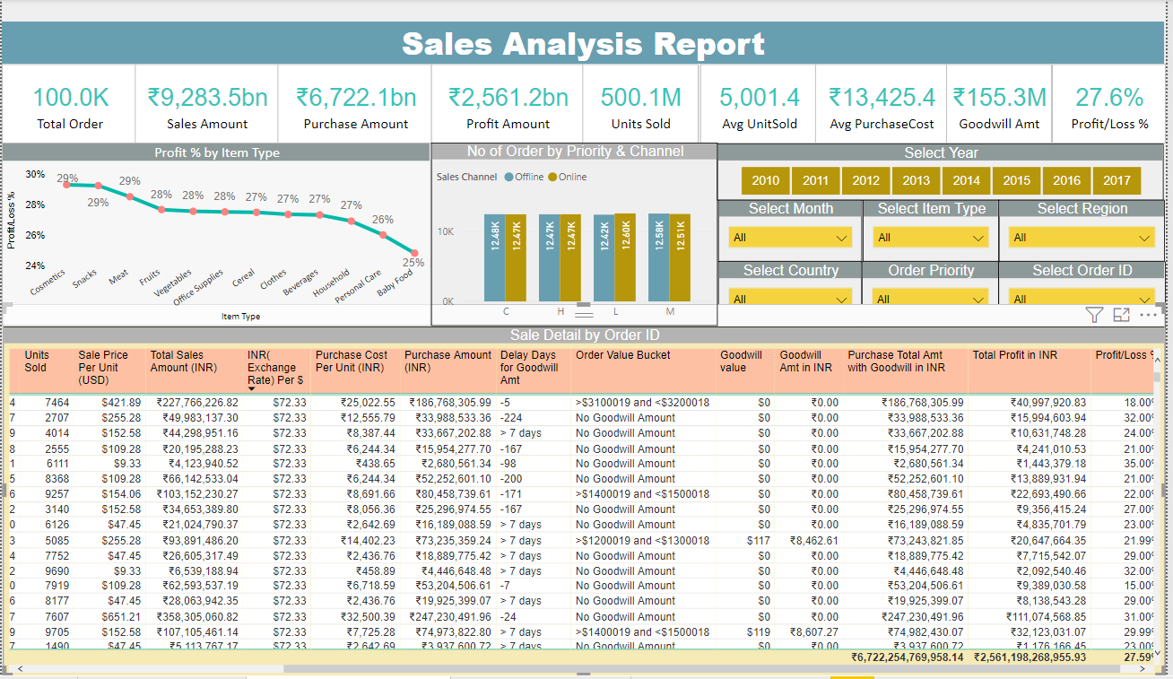
This is a descriptive report having all the information about Order, Priority, Sales Channel, Ship Date, Delay of Shipment, Unit sold, Purchase cost, Exchange Rate ( $ to INR), Good will amount ( Depend on order and delay of shipment TAT) and Profit etc. Its shows us the high profitable Items, and Sale Channel Order counts. Using Year Slicer, Order ID, Country we can go deep down according to user requirement and story.

Slide 6
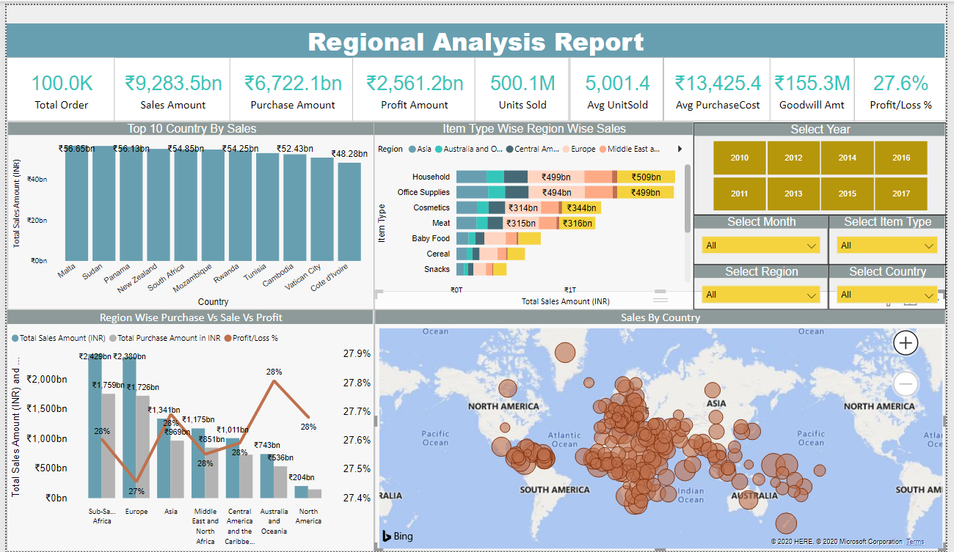
This Dashboard dedicated to Geospatial Analysis of Meera Enterprises. We can see what are top country based on Year, a particular region, and ITEM Type. Its is visual interactive dashboard shows all the country by Sales. Region wise Sales, Purchase cost and Profit. Item type wise Regional distribution of sales amount.

Slide 7
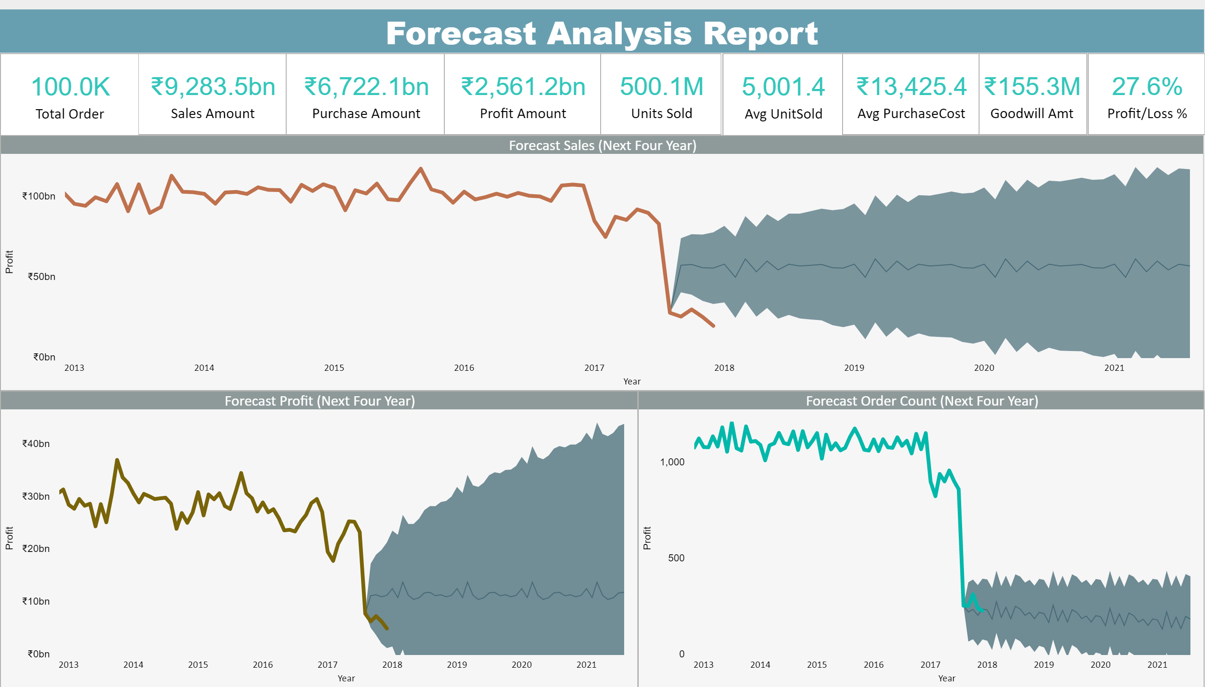
This Dashboard forecast the Sales, Profit and Order count for next four Year. Its predictive analysis based on historical Data. we have upper and lower bound values to forecast our Target value for upcoming Years.

